Slide 1
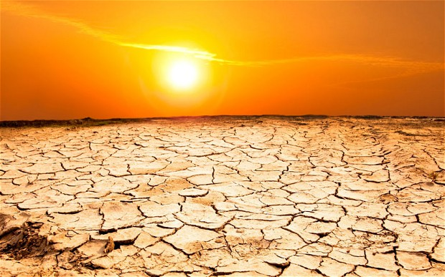
Drought

Slide 2
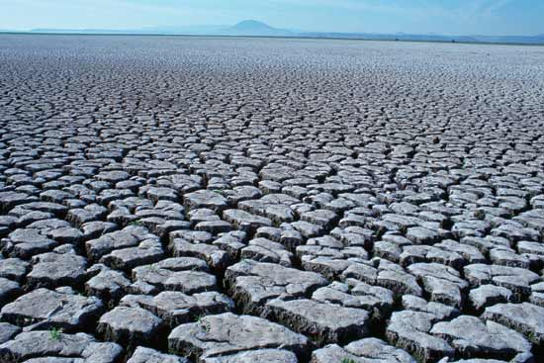
A drought is when there is a lack of precipitation over an extended period of time, usually a season or more, resulting in a water shortage for some activity, group, or environmental sector. Its impacts result from the interplay between the natural event (less precipitation than expected) and the demand people place on water supply, and human activities can exacerbate the impacts of drought.

Slide 3
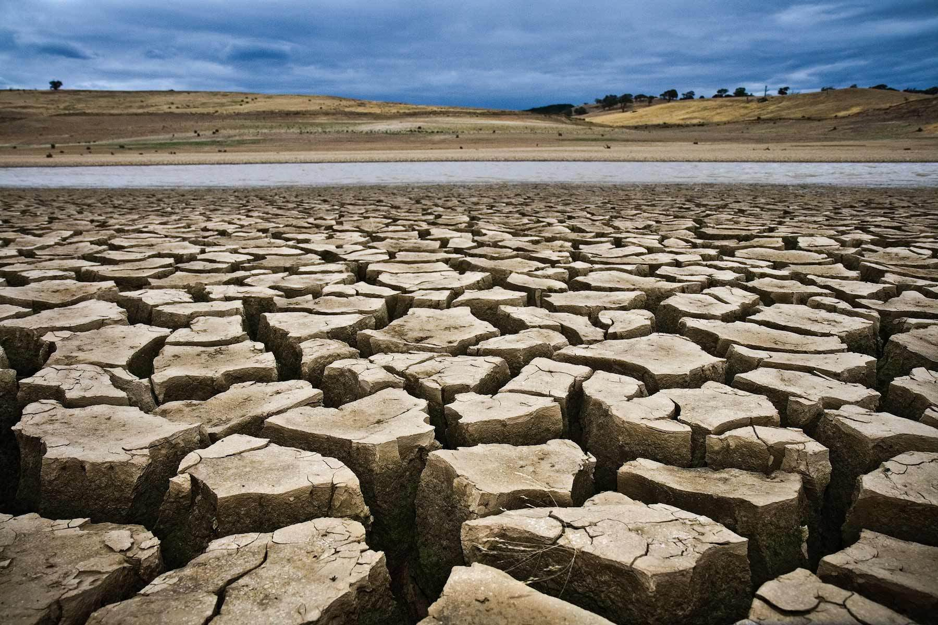
Drought has many causes . This may be caused by the reception of rain and snow over time . If you live in a place where most of the water you are using comes from rivers , dry in your area may be due to site upstream from you is not given sufficient moisture . There would be less water in the river for you and other people who live along the river to use . People can also play a big role in the drought . If we use too much water in times of normal rainfall, we may not have enough water when drought happens.

Slide 4
One of the easiest steps we can take to help mitigate the impacts of drought is conserving water. If we use water wisely at all times, more water will be available to us and to plants and wildlife when a drought happens. We can lose a lot of water doing simple everyday tasks. Did you know that turning off the water while you brush your teeth can save more than 100 gallons of water a month? If you have a leaky faucet, the drips can add up to 300 gallons of wasted water a month.

Slide 5
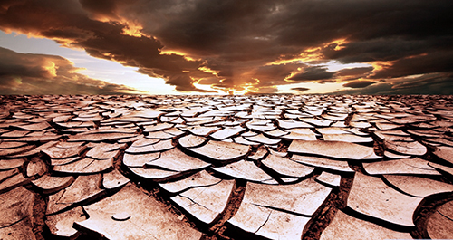
Drought affects our lives in many different ways because water is such an important part of so many of our activities. We need water to live, and animals and plants do too. We need water to grow the food we eat. We also use water for many different things in our lives, like washing dishes, cooking, bathing, and swimming or river rafting. Water is also used to help make the electricity we use to run the lights in our houses and the video games you may like to play. When we don’t have enough water for these activities because of a drought, many people and many different things will be affected in many different ways.

